Slide 1
COLORING OUTSIDE THE LINES

Slide 2
“When you fall back on what’s easy and safe, you’ll stay earthbound.” ~Donald Maass

Slide 3
Takes Courage
It takes an enormous amount of courage – and risk– to grab your crayons and color your story the way you want. But the payoffs can make it immensely worthwhile.

Slide 4
It’s writing something that you want to say.
Something that matters to you, terrifies, outrages, inspires, hurts and heals.

Slide 5
Be Fresh, Be Authentic, Be You
Bend, Twist, Color in the Shades YOU want
Stay true to your Inner Compass

Slide 6
It challenges you to take a journey unlike any you’ve ever taken then finding a part of yourself that was buried deep inside you all along.

Slide 7
HOW TO BEGIN
Take your favorite kind of fiction and narrow it to a single element that speaks to you.
A super hero
Orphans
Outlaws or a band of cowboys
A person stranded on an iceberg alone
Then totally reverse it
Orphans stranded on a melting iceberg
Twist, Bend, Shape it differently from everyone else’s

Slide 8
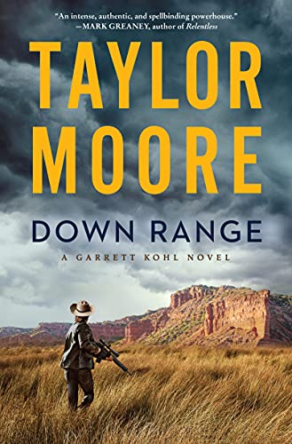
Anatomy of Down Range
Focused on family ties
Western Elements (Implemented Horses)
Western Phrases
Panhandle History - Comanches
Children in Peril
Very unique setting
Small town
An Evil group of people

Slide 9
Final Words
Make your story one that no one has read before…but something a reader can relate to.

