Slide 1
Love ‘em or Hate ‘em
But Make a Reader Care

Slide 2
What is one thing that EVERYONE WANTS?
Fancy cars
Luxurious Houses
Lots of Money
High Paying Job
European Vacations
More Time

Slide 3
Emotion anchors us to life, connects us to our inner core.
Emotion stems from:
Darkest Fears – Buried Rage - Injustice
Deepest Longings
Secrets Kept
Passion – Unhealed Wounds
Wrong Decision That Costs
Emotion is the key that unlocks everything inside us.

Slide 4
So How Do We Make a Reader Care?
THEME
Metaphor
Simile
Parallels
Dialogue
Physical Response
CONFLICT

Slide 5
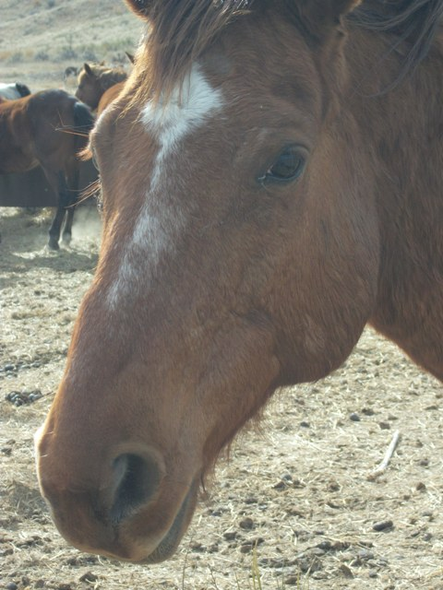
Straight From the Horse’s Mouth
START WITH GOOD BASICS
Strong Verbs that draw pictures
Avoid Passive Writing
Cut Words that tell us Nothing
Avoid Ambiguity
Effective Dialogue
Cut Deadwood
Strong Hooks

Slide 6
Conflict, Conflict, Conflict
Conflict is not a misunderstanding
It’s an interior war
Something twists and knots a character up
Sometimes, that inner conflict cannot be resolved, and a character must make peace with it, to learn and move on.
Hopefully, as a better, changed person

Slide 7
Turn a flaw or shortcoming into a struggle that involves:
Defeat
Costs
Crisis
Change

Slide 8
To Lift a character high, they must sink low
KEEP UPPING THE STAKES
Test
Torment
Transform
A Healing Journey Resonates
With Readers

Slide 9
Make your Characters Hurt. Make them Bleed.
The Deeper the Problem, the more
Heightened the Emotion
Adding Emotion is Hard!!
JUST DO IT!

Slide 10
When a character is at the absolute lowest, what is the first thing he/she does differently?

Slide 11
Emotion is finding the right balance
between Drama and Reality

Slide 12
What are your emotional
triggers?

